Slide 1
CSE231 – Digital Logic Design
Decoders and Encoders

Slide 2
Definitions
Active – the function is being performed
  Active low – active when the output is 0.
  Active high – active when the output is 1.
Enabled – active circuit can perform its function
  Low-level enabled
    circuit performs its function when Enable = 0.
  High-level enabled
    circuit performs its function when Enable = 1.

Slide 3
Decoders

Slide 4
Decoder
A decoder selects 1 of 2^{N} output lines by decoding a binary value on the N input lines.
(similar to a 1-to-2^{N} Demultiplexer)

Slide 5
Decoder: N-to-2^{N}
w
0
y
0
N
inputs
2
N
w
n
–
1
outputs
Enable
y
2
n
–
1
En
Active-high or active-low
Active-high or active-low

Slide 6
Decoder: 2-to-4
x
D₀
x
y
D
0
D
1
D
2
D
3
y
0
0
1
0
0
0
D₁
0
1
0
1
0
0
1
0
0
0
1
0
1
1
0
0
0
1
D₂
D₃
active-high output

Slide 7
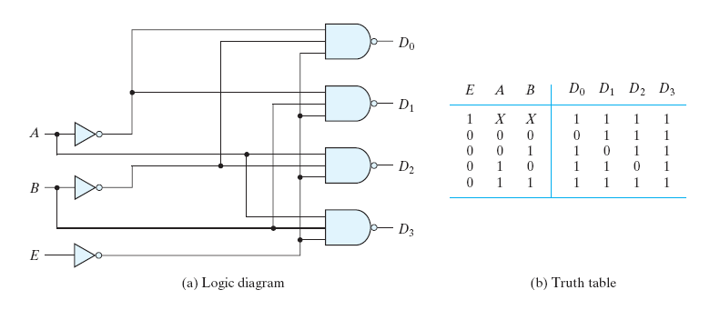
Decoder: 2-to-4 with Enable
0
active-low output

Slide 8
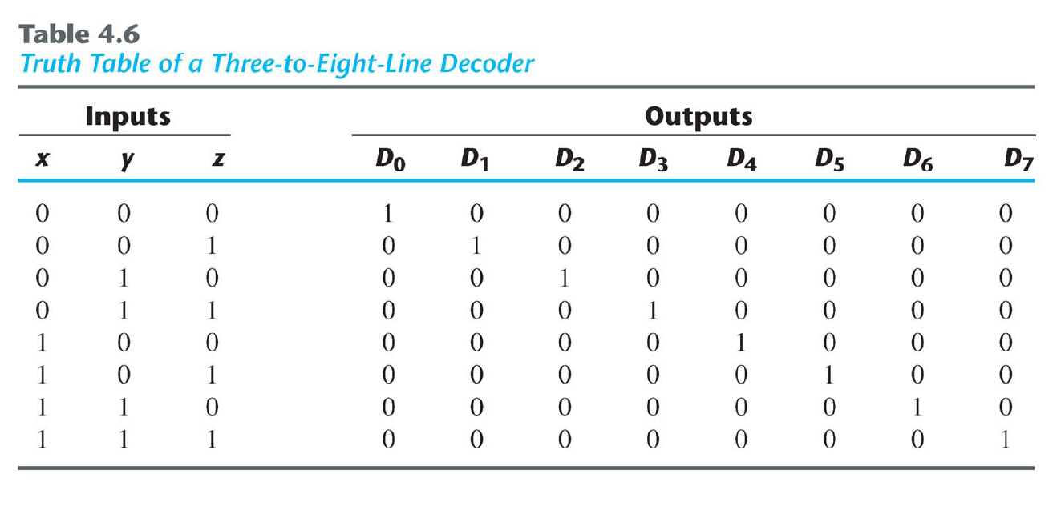
Decoder: 3-to-8

Slide 9
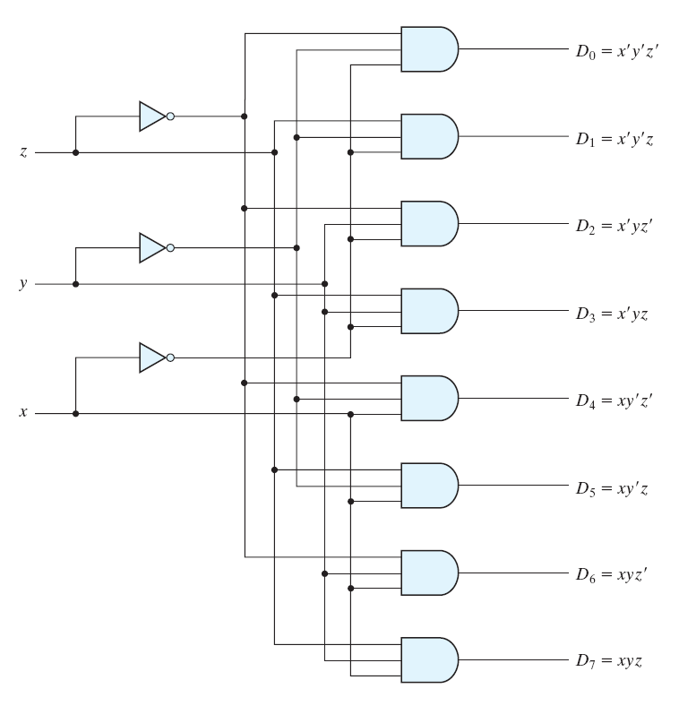
Decoder: 3-to-8

Slide 10
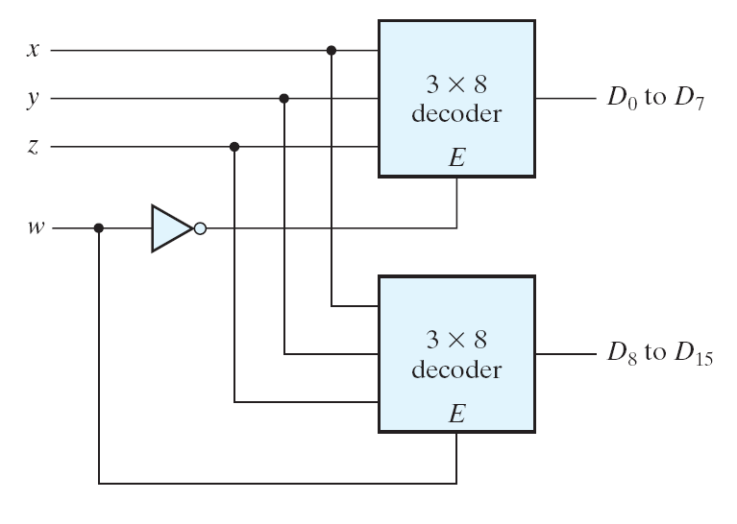
Decoder: 4-to-16

Slide 11
Decoders
Designing Logic Circuits
using Decoders

Slide 12
Decoders: Designing Logic Circuits
Each row in a Truth Table corresponds to a minterm
Each minterm can be mapped to a decoder output
For each row in the Truth Table, where the output of the function is one (F = 1),
  Sum (“OR”) the corresponding outputs of the decoder to realize the logic function

Slide 13
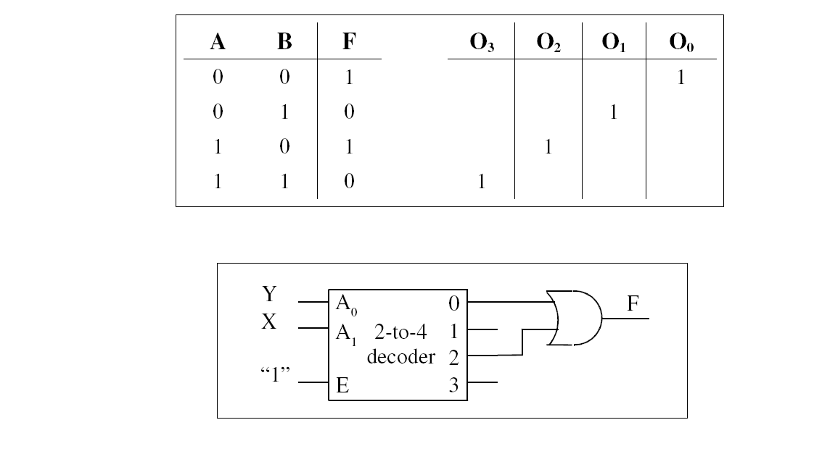
Decoders: Designing Logic Circuits
F = Σm(0,2)

Slide 14
Decoders: Designing Logic Circuits
Exercise:
Design a circuit, using a 3-to-8 Decoder to realize the Boolean expression given below.
F_{X,Y,Z} = Σm(1,2,5,7)

Slide 15
Decoders: Designing Logic Circuits
Exercise:
Design a circuit, using 2-to-4 Decoders to realize the Boolean expression given below.
F_{X,Y,Z} = Σm(1,2,5,7)

Slide 16
Decoders: Designing Logic Circuits
Exercise:
Design a Full Adder using a 3-to-8 Decoder.

Slide 17
Full Adder:
Sum = X xor Y xor Z
Carry = X.Y + X.Z + Y.Z

Slide 18
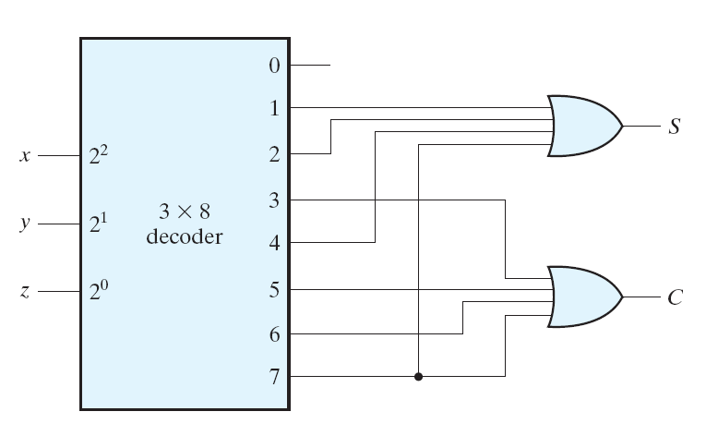
Decoders: Designing Logic Circuits
Full Adder

Slide 19
Encoders

Slide 20
Encoder
An encoder outputs the binary value of the
active input.
An encoder has 2^{N} inputs and N outputs.

Slide 21
Encoder
Inverse operation of the decoder
  Decoder selects one output based on the input binary number.
  Encoder outputs a binary number based on the selected input.
Issues
  What if more than one input is active?
  What if no inputs are active?

Slide 22
Encoder: 2^{N}-to-N
w
0
y
0
2
N
N
inputs
outputs
y
n
–
1
w
2
n
–
1
The active (or selected) input is encoded on the n outputs.

Slide 23
Encoder: 4-to-2
w
3
w
2
w
1
w
0
y
1
y
0
0
0
0
1
0
0
0
0
1
0
0
1
0
1
0
0
1
0
1
0
0
0
1
1
w
0
w
1
y
0
w
2
w
y
1
3

Slide 24
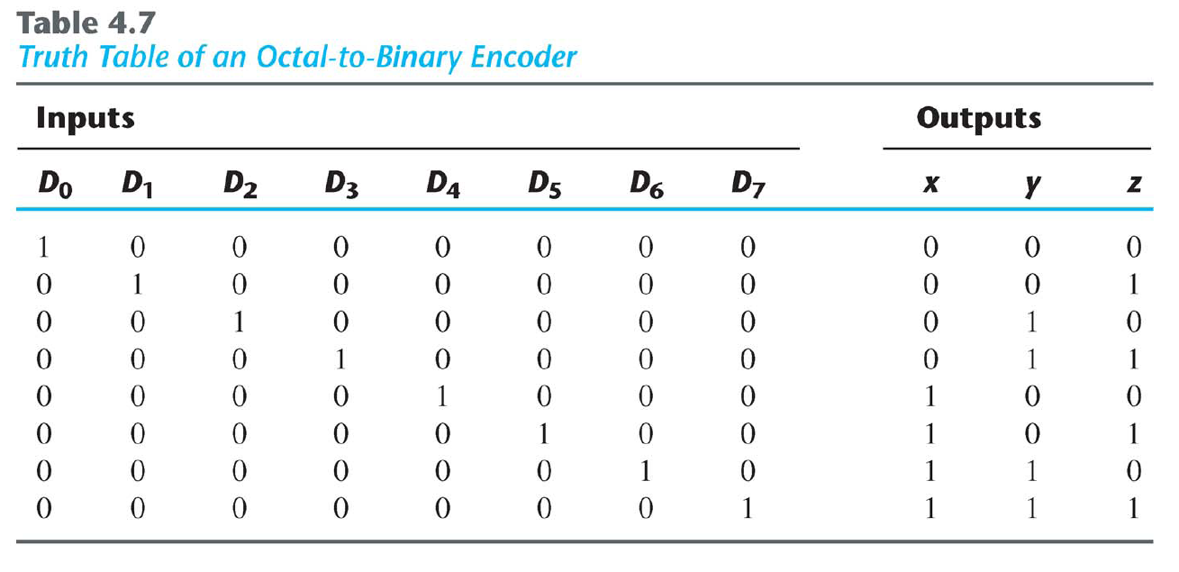
Encoder: 8-to-3

Slide 25
Priority Encoder
Higher-order input has priority of lower-order input
  Order of the input determined by its binary value
    I0 has binary value 000 (0)
    I1 has binary value 001 (1)
    I2 has binary value 010 (2)
    I3 has binary value 011 (3)
    etc.
  So,
    I1 selected over I0
    I2 selected over I1 and I0
    I3 selected over I2, I1, and I0
    etc.

Slide 26
Priority Encoder
Valid indicator
  Output signal of the (priority) encoder that indicates the validity of the encoded output
  Encoded output is invalid when no inputs are selected or when the encoder is disabled
    V = 0 (indicates invalid encoded output; active high)
  Encoded output when one, or more, input(s) is (are) selected, and encoder is enabled
    V = 1 (indicates valid encoded output; active high)

Slide 27
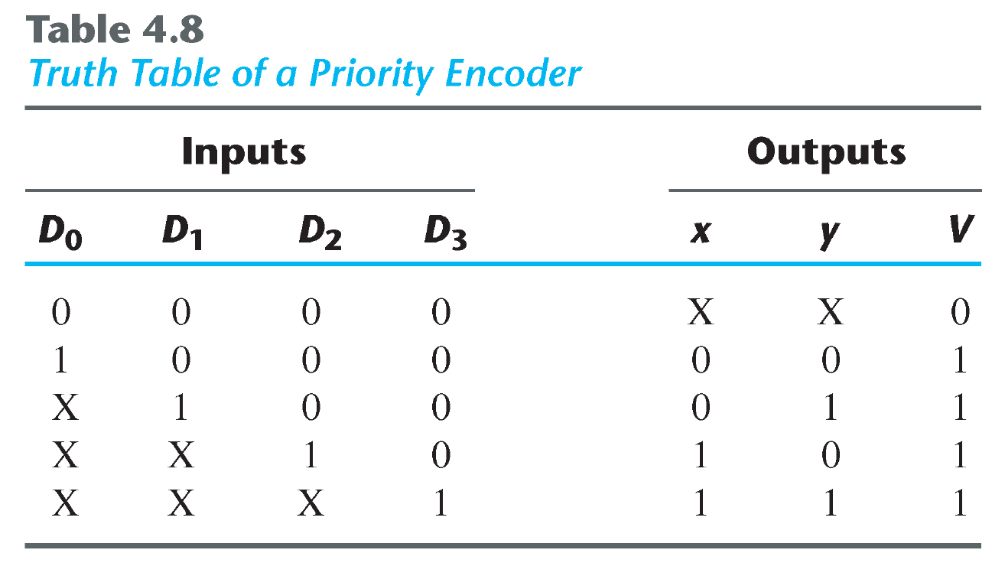
4-to-2 Priority Encoder
Valid indicator
invalid
valid

Slide 28
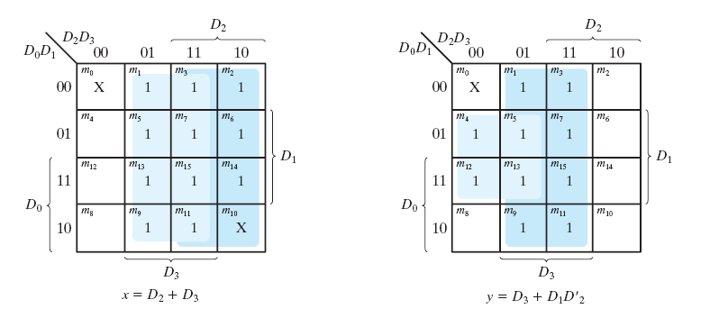
4-to-2 Priority Encoder
1

Slide 29
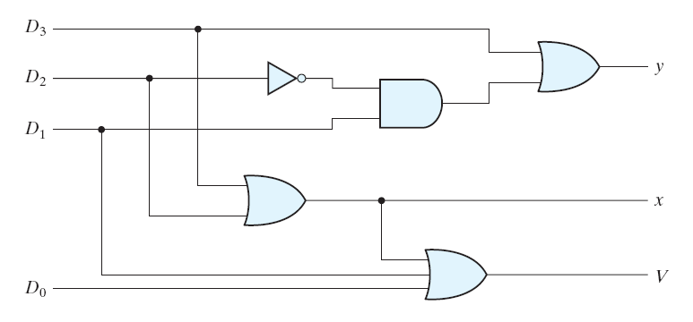
4-to-2 Priority Encoder

Slide 30
Tri-state Devices

Slide 31
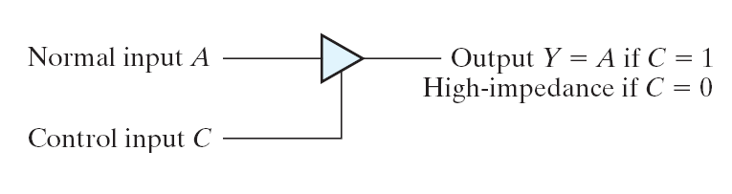
Tri-state Devices

Slide 32
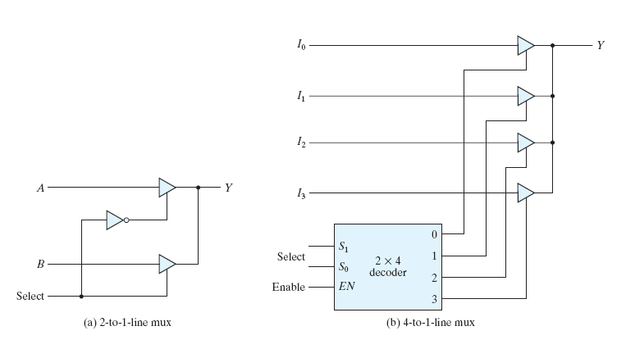
Tri-state Devices

Slide 33
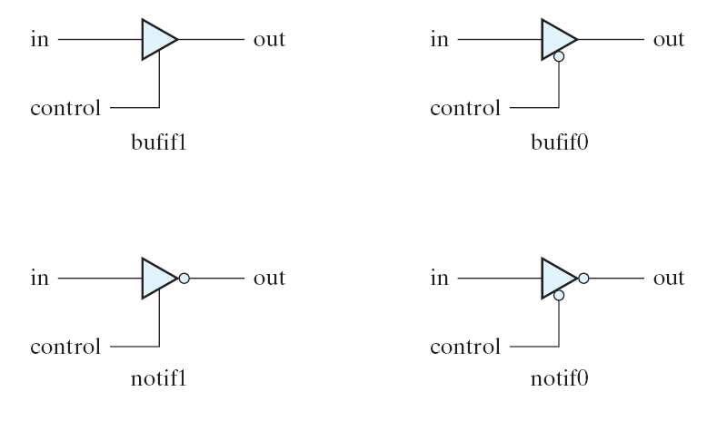
Tri-state Devices

Slide 34
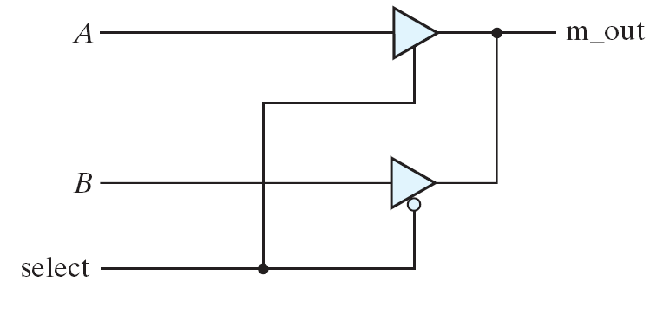
Tri-state Devices

